Slide 1
Turkey Inflation Crisis

Slide 2
PROBLEM DEFINITION
Problem Statement: This project’s problem statement is to “study the impact of changes in the monetary policy of Turkey on inflation and other economic determinants”. We will closely look at the reverberations of the ongoing inflationary crisis in Turkey.

Slide 3
SERIES OF EVENTS
Liberal policies – 2000
External Debt
2017 Constitutional Referendum
2018 Interest Cuts
2018 – Currency / Inflation Crisis
CURRENT RATE OF INFLATION: 61.14%
Applying the Contractionary Monetary Policy is the only solution that can put the country on a way out of this crisis, but the conflicting views of the President and the Central Bank is causing the deceleration in the progress.
Politicization of economic policy
The need for a robust monetary regime
Impact of larger crises
Successive interest rate cuts

Slide 4
SUGGESTED SOLUTION AND EXPLORATORY DATA ANALYSIS
Suggested Solution: We try to identify those predictors and the degree of their effect on TRYUSD; whether measures taken to ameliorate those predictors would lead to an improvement in the exchange rate, thereby bringing down inflation.

Slide 5
Quarterly Economic Data 1990-2021
DATA CONSIDERED
Gross External Debt, Real Effective Exchange Rate, Balance of Payments, Exports and Imports, Reserve Assets, GDP, Interest Rate, TRYUSD, CPI, DPPI, Unemployment, Jobs, Industrial Production, Electricity Production, Private Final Consumption Exp, Govt. Final Consumption Exp, M3, Residential and Dwelling Permits
GDP by Economic Activity
Cost of living
Agriculture
Manufacturing
Services
Information and Communication
Financial & Insurance Activities
Professional/Administrative Service
Public Service
Others
Food, Heat, Rent, General Index, Household, Miscellaneous.
FDI by Sectors
FDI in Agriculture
FDI in Industry
FDI in Service

Slide 6
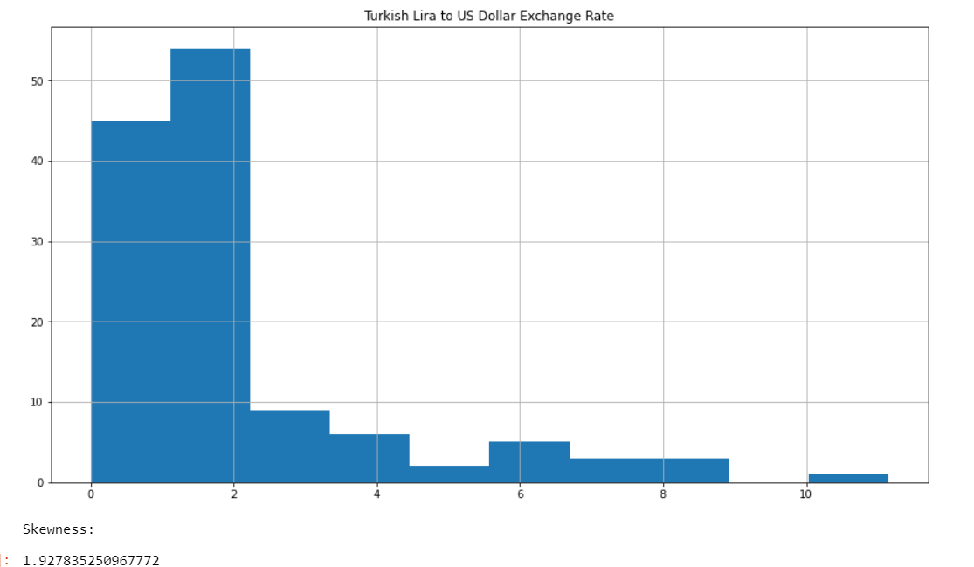
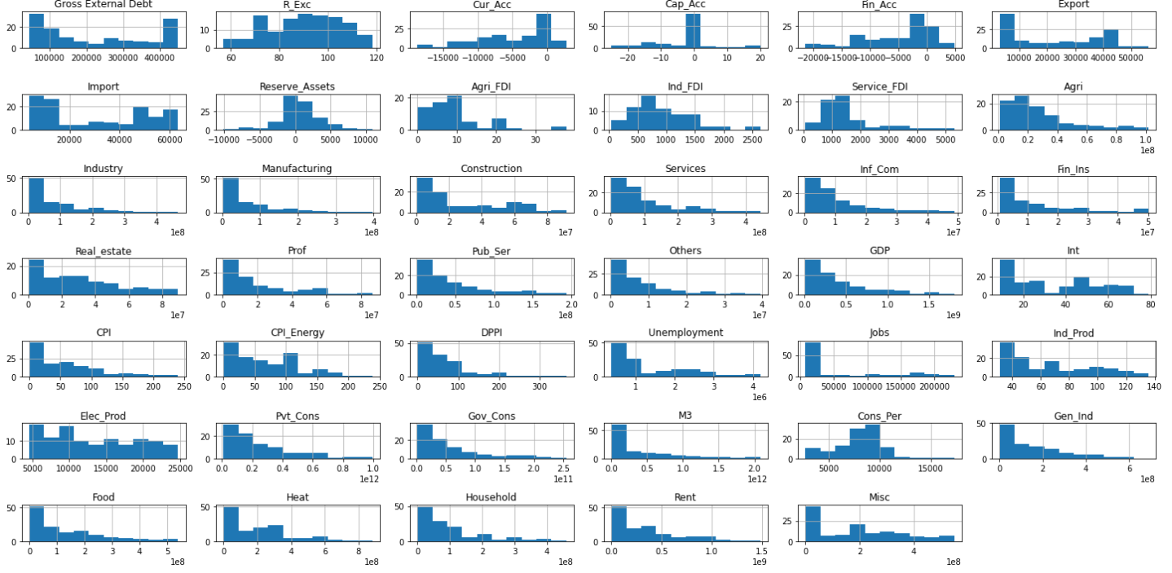
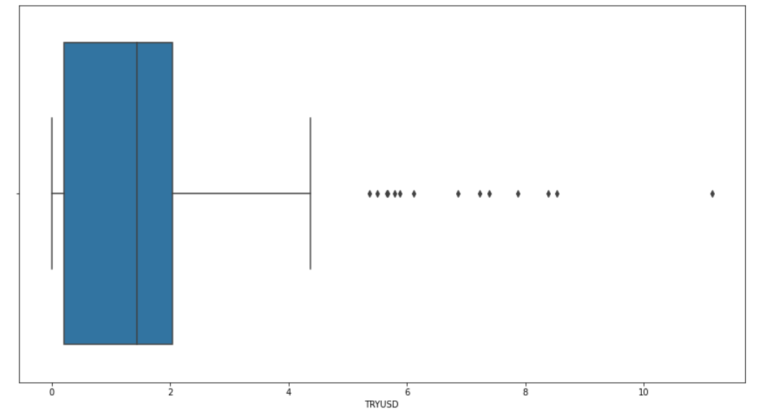
Distribution of numeric independent variables
Distribution of Dependent Variable
Outlier Treatment

Slide 7
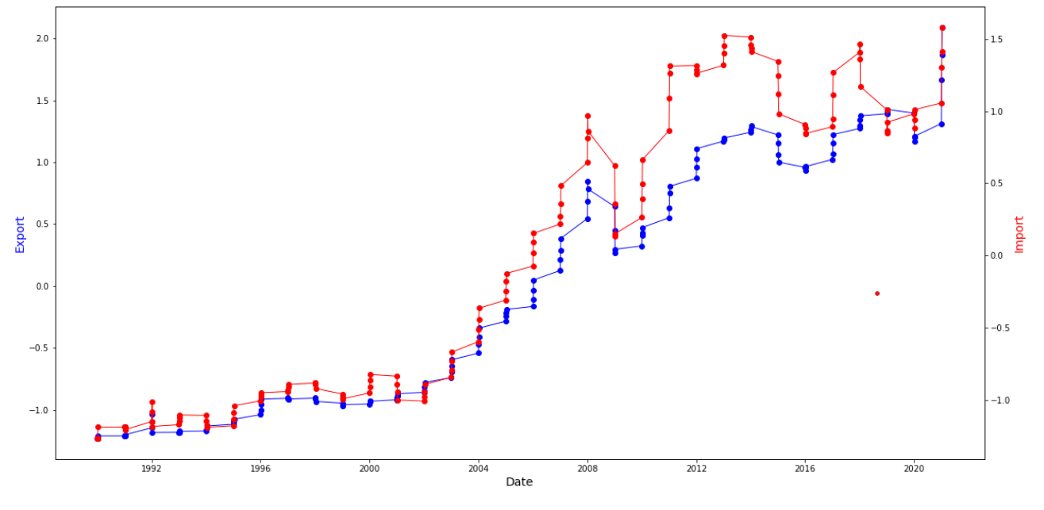
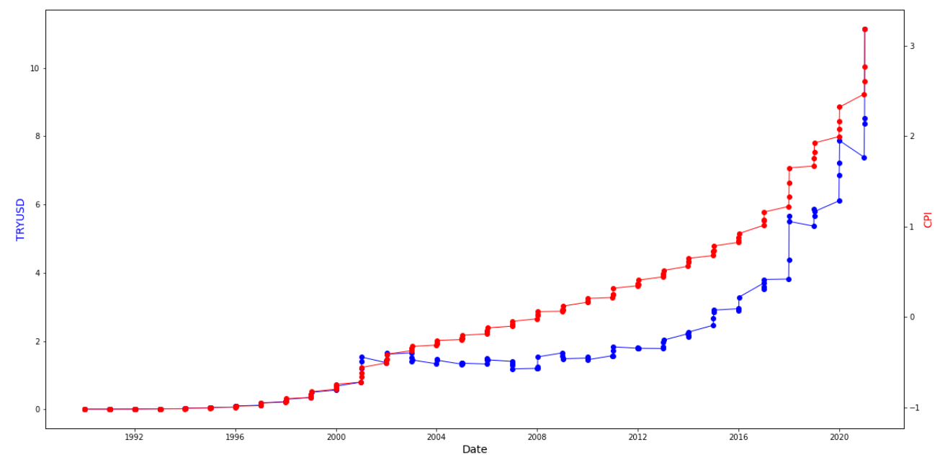
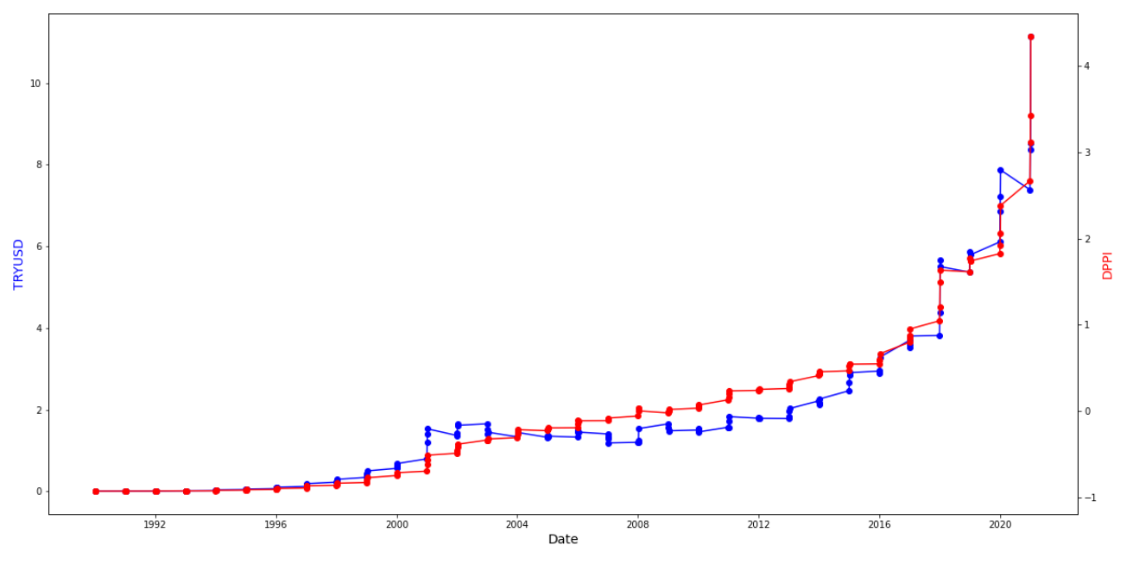
Exports and Imports over Time
EDA
Relationship between TRYUSD
and CPI with Time
Relationship between TRYUSD and DPPI with time

Slide 8
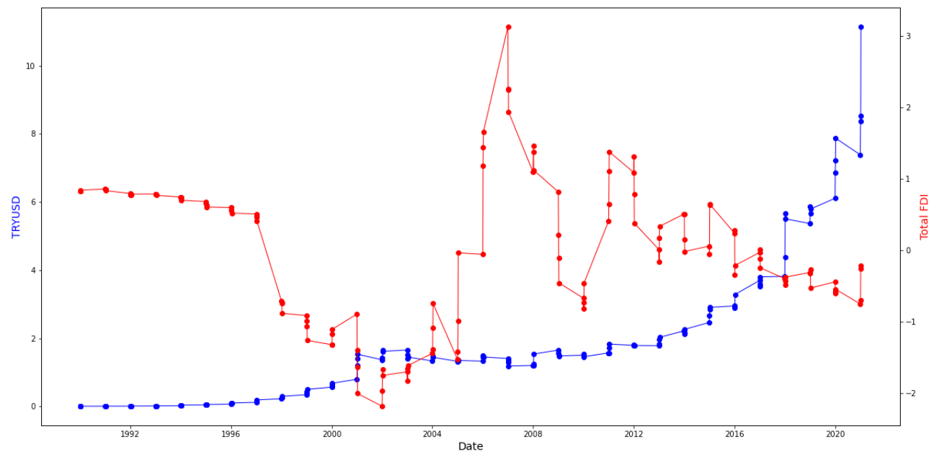
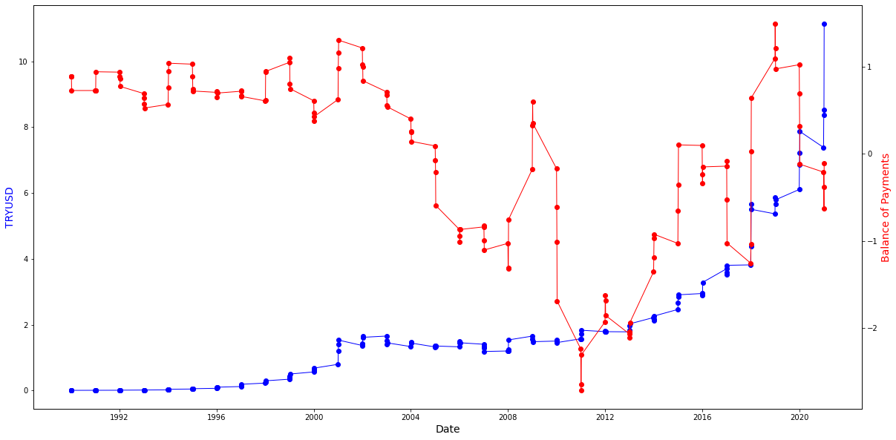
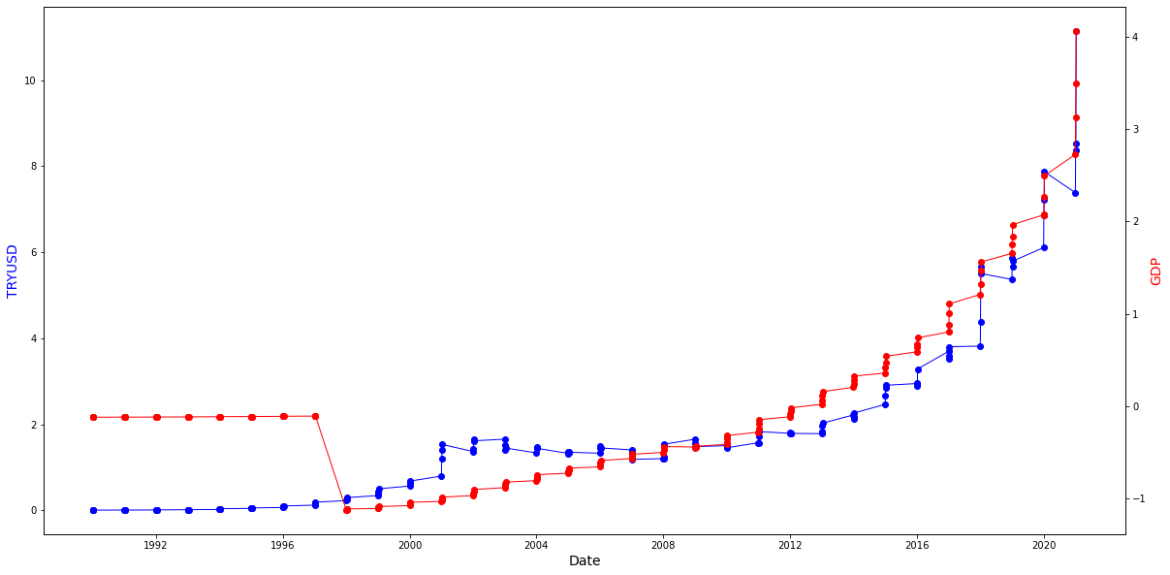
Relationship between TRYUSD and Total FDI over time
Relationship between TRYUSD
and BOP with time
Relationship between TRYUSD and GDP with time

Slide 9
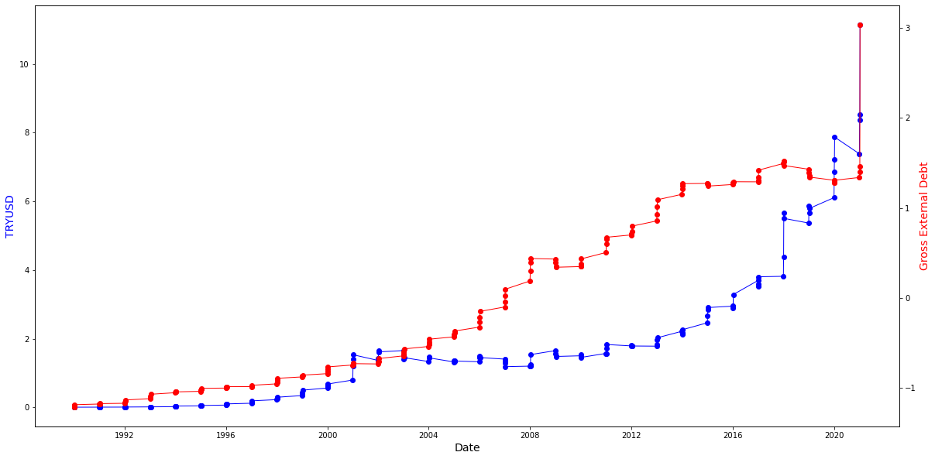
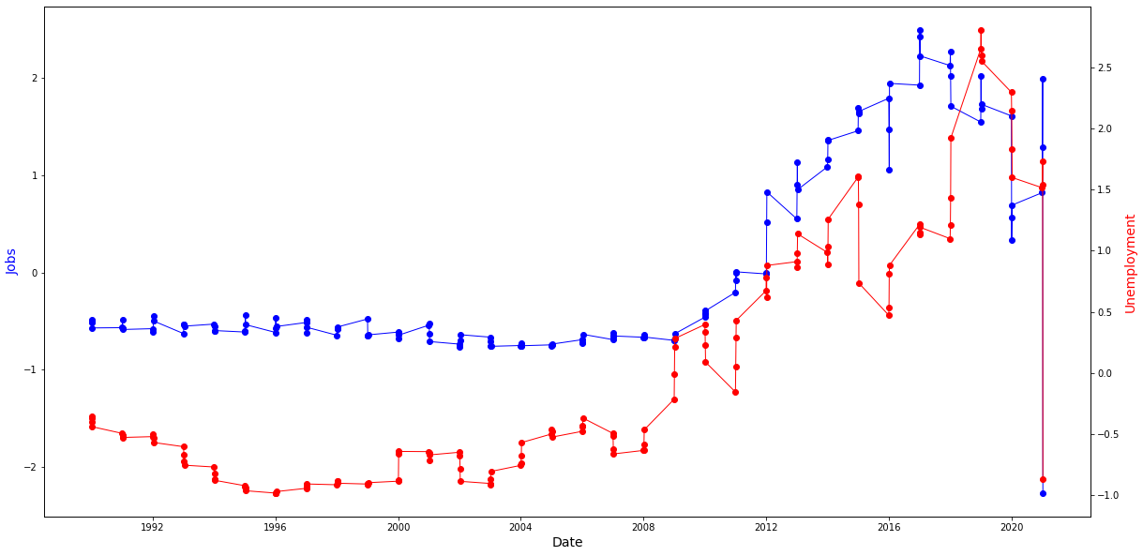
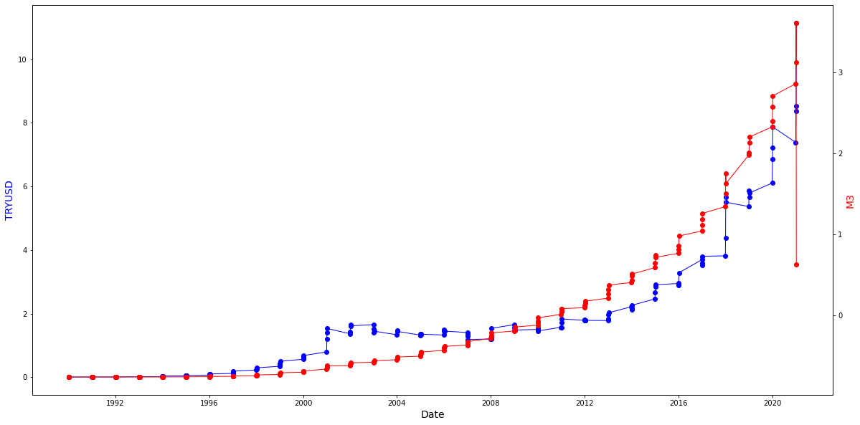
Relationship between TRYUSD and Gross External Debt over time
Relationship between Jobs and Unemployment over time
Relationship between TRYUSD and M3 with time

Slide 10
ALGORITHMS, SOLUTION AND CONCLUSIONS

Slide 11
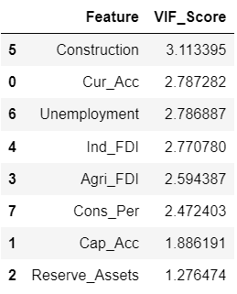
Hypothesis Testing | Pvalue<0.05
Interest Rate and TRYUSD | 0.000
Total FDI and TRYUSD | 0.022
BOP and TRYUSD | 0.064
Financial Account and TRYUSD | 0.496
M3 and TRYUSD | 0.000
STATISTICAL
SIGNIFICANCE
TREATMENT OF MULTICOLLINEARITY

Slide 12
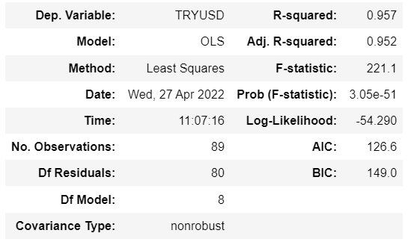
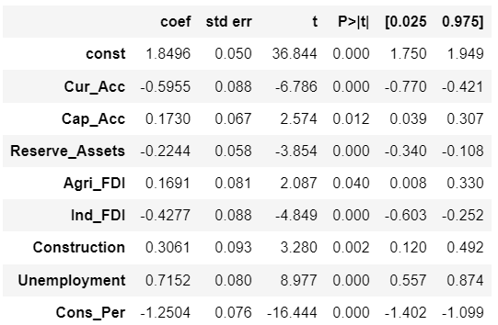
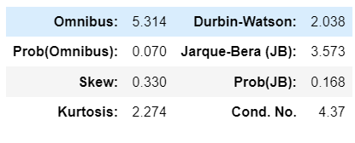
Multivariate Linear Regression – Ordinary Least Squares Method

Slide 13
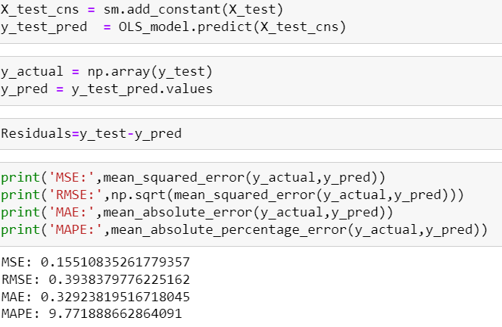
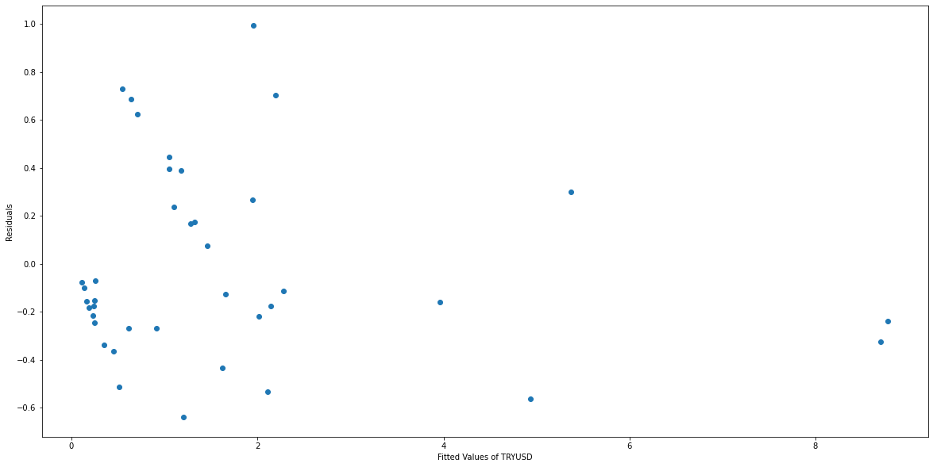
Model Evaluation

Slide 14
THANK YOU

